Slide 1

AI DRIVEN ADJUSTMENT OF PUBLIC IMAGES/VIDEOS FOR COMPLIANCE TO GENERAL DATA PROTECTION REGULATION (GDPR)
November 3, 2022

Slide 2
Group Members
Dharmesh Patel
Jemty Jose
Muhammad Azhar Mehboob
Muhammad Suleman

Slide 3
Table of Content
Introduction
Objectives
Literature Overview
Scope & Requirements
Limitations
Timeline
Reference

Slide 4
Introduction
The use of video surveillance and smartphones has been increased throughout the world over time.
Consent of an individual is required for certain security purposes.
To avoid any misuse of data.
To make sure that the privacy of an individual is protected, the European Union has framed the GDPR (General Data Protection Regulation)
In this presentation, we will be briefly going through the GDPR and implementation of this regulation using an AI model.

Slide 5
Objective
To make sure that images or video that are captured follow the General Data Protection Regulations.
Link GDPR and AI
Use Computer Vision to detect and blur parts of the images that reveal personal identity.
Develop ML models with a low false negative approach for removing the features

Slide 6
Literature Review
GDPR
A law framed by the European Union (EU) to protect the fundamental rights and freedoms, particularly the right to protection of personal data of an individual.
Personal Data[1] includes:
Facial Biometric Information
Location Data
Vehicle Registration Plates
Important Legal Documents
Online Identifier

Slide 7
Literature Review
German Law
As per the German Law, the identity of any individual should not be revealed under any circumstances unless consented or for legal reason [3].
Capturing of any photo or video that intrudes into a person’s privacy is prohibited by law in germany.
We need to make sure that the person can't be recognised in accordance with GDPR. Others include
,Tattoos
Clothes
Jewelry
Any Photo or Video which shows the helplessness of a person should not be shared.

Slide 8
Scope and Requirement
Build upto 3 Image Detection ML Models
Detect and blur Objects according to GDPR such as Human Face, Vehicle Registration number and Legal Documents including Passport, Driver’s License etc.
Build the AI model using CNN/OpenCV & TensorFlow

Slide 9
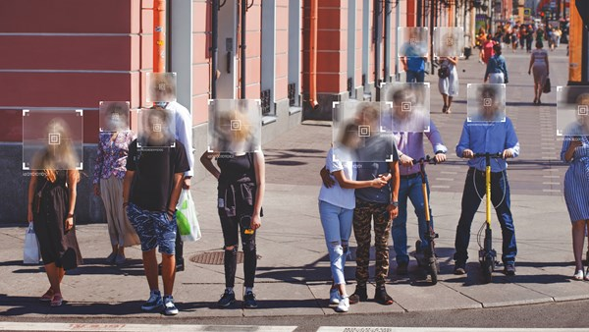
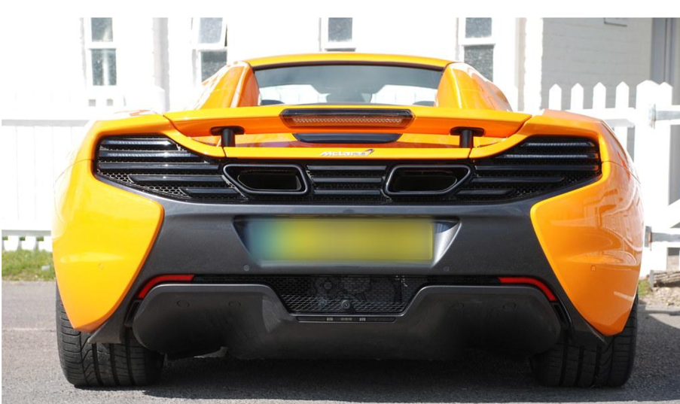
Scope and Requirement

Slide 10
Limitations
No ML Model is 100% accurate
Cannot Unblur a “Celebrity”/ Public Figure
Identification of special features (tattoos)

Slide 11
Timeline
11 Oct-02 Nov
16 Nov- 02 Dec
09 Dec- 18 Dec
Research
Data
Collection
Building
ML Code
Implementation
of Dataset in Code
Training,
Testing & Validation
Results &
Report Submission
03 Nov- 15 Nov
03 Dec- 09 Dec
19 Dec - 21 Dec

Slide 12
Reference
https://bisa.tech/insights-and-research/58-gdpr-data-subject-rights.html
https://www.europarl.europa.eu/RegData/etudes/STUD/2020/641530/EPRS_STU(2020)641530_EN.pdf
https://allaboutberlin.com/guides/photography-laws-germany#how-do-i-get-permission

Slide 13
THANK YOU

